Slide 1
Cooperative AI for Don’t Starve Together
Fábio Almeida
Professor Rui Prada
Samuel Mascarenhas

Slide 2
Outline
Motivation
Objective
Don’t Starve Together
Social Agents
PsychSim
CiF
FAtiMA
Versu
An Architecture for Believable Socially Aware Agents
Solution
Planning

Slide 4
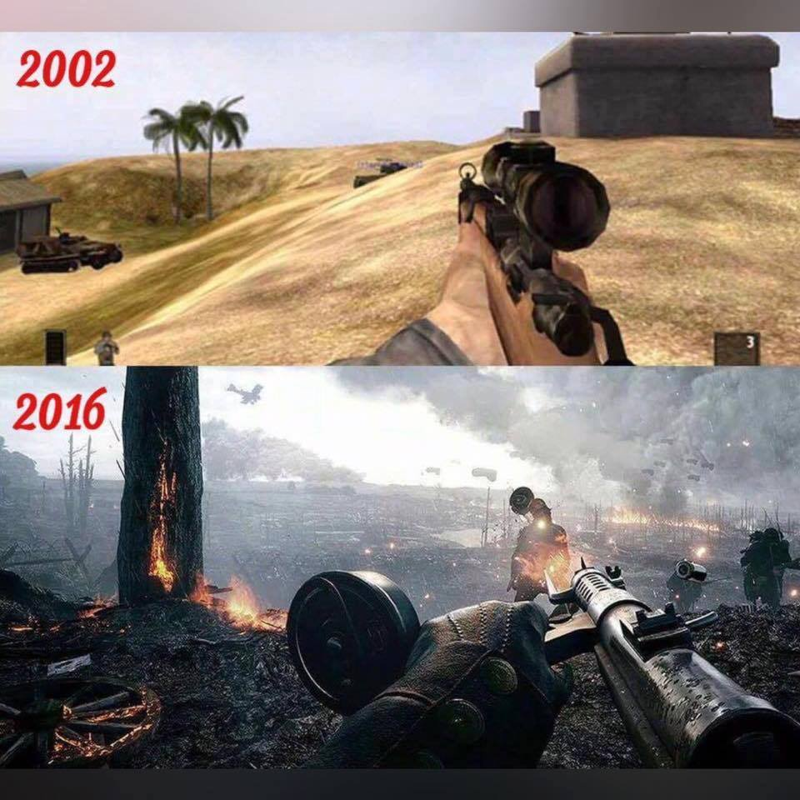

Slide 5
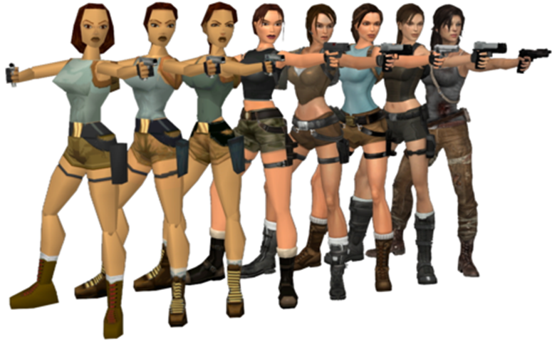

Slide 6
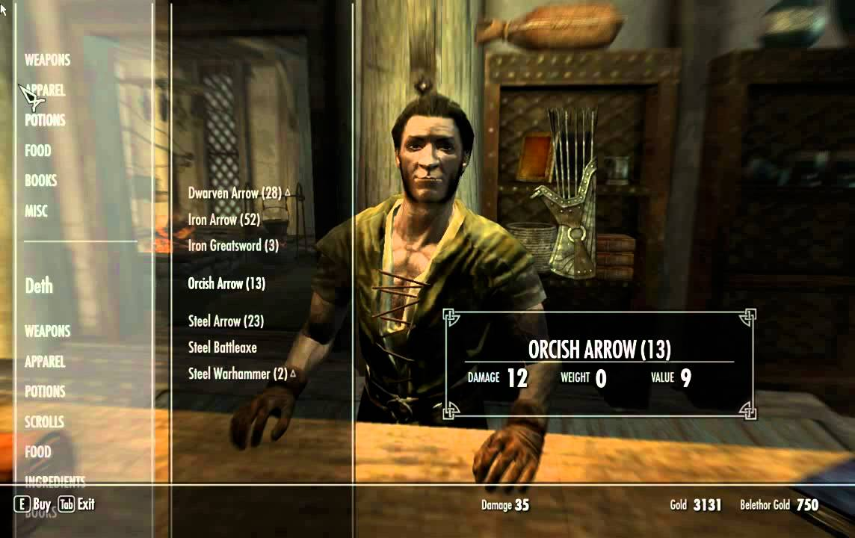

Slide 7
Objective
Can we improve a player’s game play experience in Don’t Starve Together using social agents?

Slide 8
Objective
Can we improve a player’s game play experience in Don’t Starve Together using social agents?

Slide 9
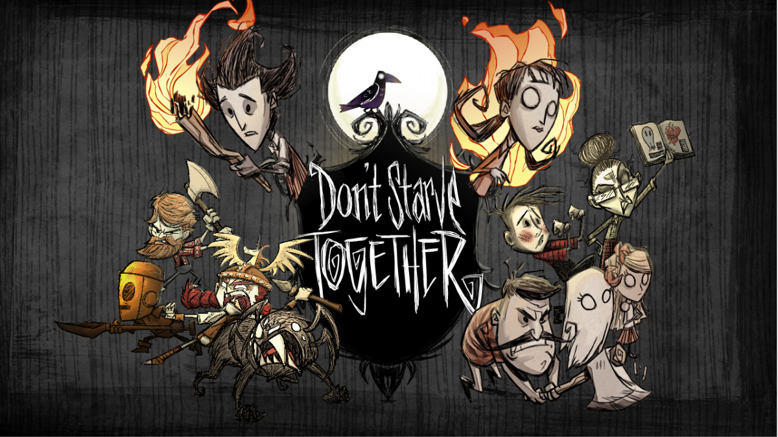
Don’t Starve Together
Notes:
Introduction to DST
Launched April 21st 2016
CCU: 5000-9000

Slide 10
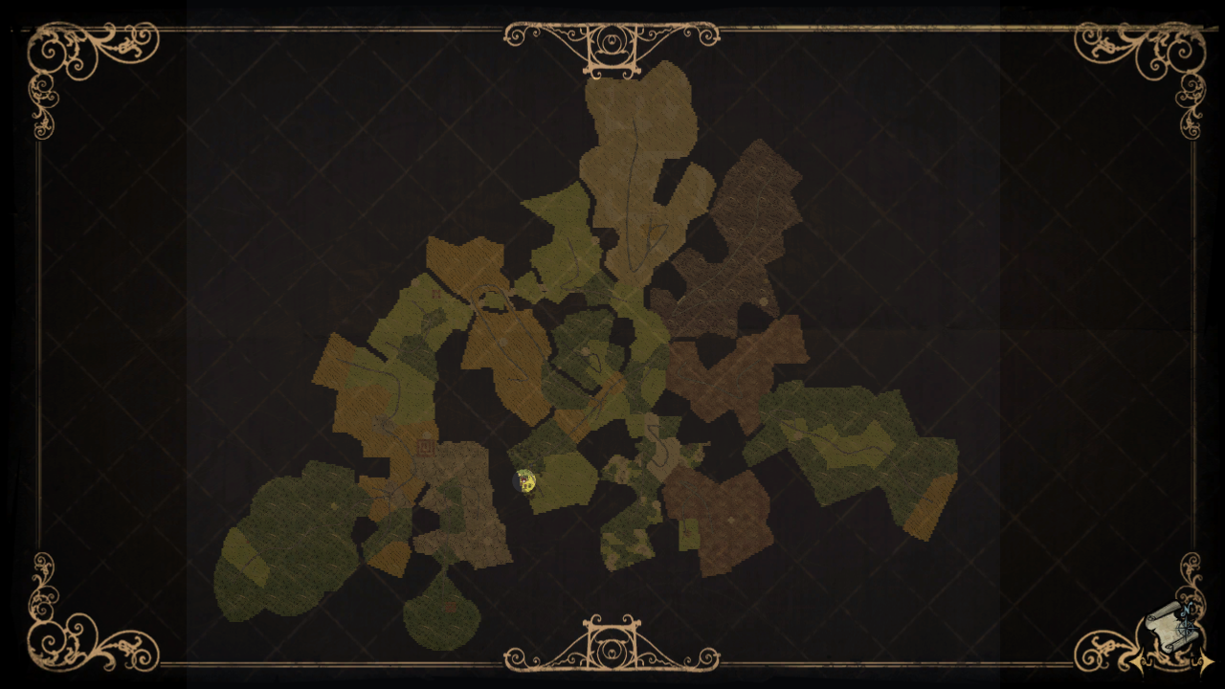
The World
Notes:
Talk about the different biomes of the world
Each biome has different characteristics, resources , and dangers

Slide 11

Player’s Characteristics
Notes:
Hunger Health and Sanity Explain them

Slide 12
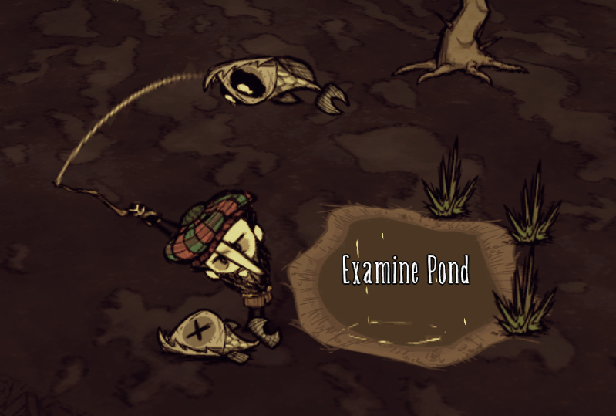
General Gameplay
Notes:
Describe a playthrough

Slide 13
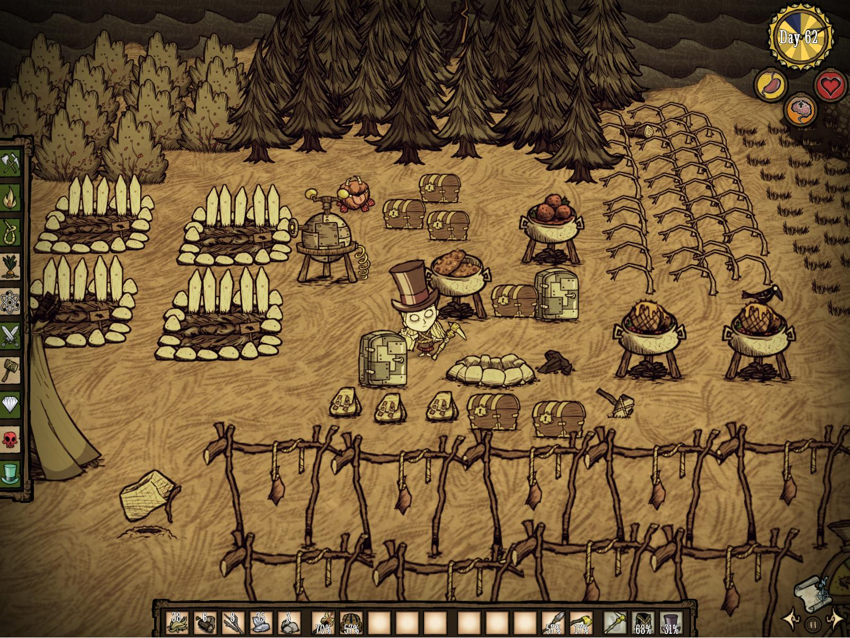
General Gameplay
Notes:
Describe a playthrough

Slide 14
General Gameplay
Collecting
Exploring
Prototyping
Crafting
Building
Fighting
Settling
Socializing
Notes:
Finish up by summing up the general actions

Slide 15
Agents

Slide 16
Intelligent Agents
Reactivity
Proactiveness
Social Ability

Slide 17
Social Agents

Slide 18
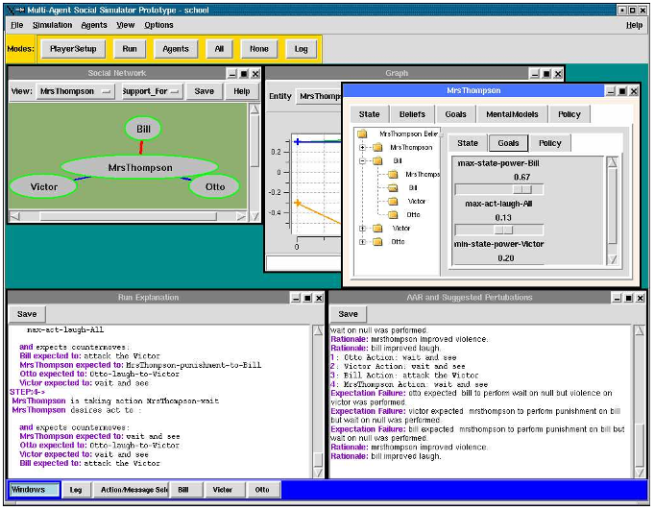
PsychSim

Slide 19
CiF

Slide 20
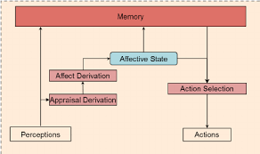
FAtiMA

Slide 21
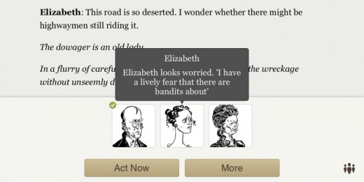
Versu

Slide 22
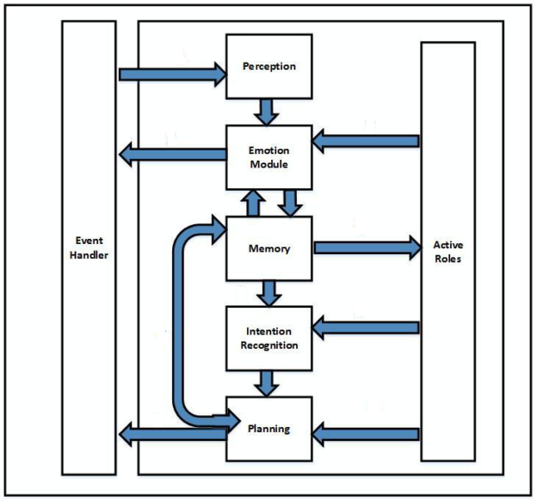
An Architecture for Believable Socially Aware Agents

Slide 23
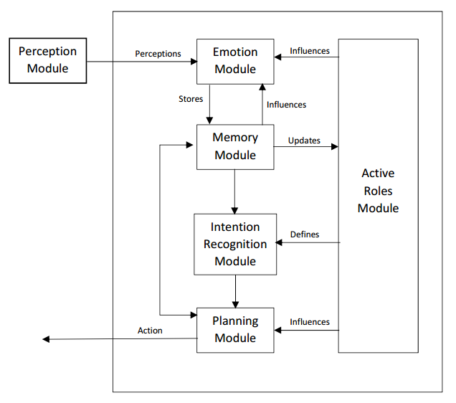
Solution

Slide 24
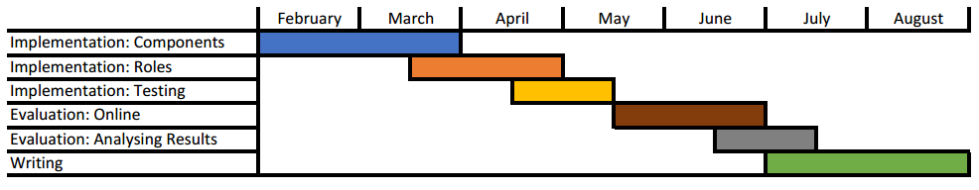
Planning

